Slide 1
Production, Cost & Revenue

Slide 2
Let’s Read………….
In the fall of 1990, a British scientist named Tim Berners- Lee invented the World Wide Web.
This remarkable idea paved the way for the creation of thousands of profitable businesses that include Facebook and Twitter, Apple, Microsoft, Google, and Yahoo!.
Some of these successful dot.com firms sell goods and others sell services.
But many firms don’t make the things they sell.They buy them from other firms. For eg, Apple doesn’t make the iPhone. Intel makes its memory chip and Foxconn, a firm in Taiwan, assembles its components.

Slide 3

Let’s Think………….
Why doesn’t Apple make the iPhone?
How do firms decide what to make themselves and what to buy from other firms?
How do Facebook, Twitter, Apple, Microsoft, Google, Intel, Foxconn, and the millions of other firms make their business decisions?
Notes:
firms and the choices they make

Slide 4

What is Production?
Production is the transformation of inputs into output.
Production creates utility.

Slide 5
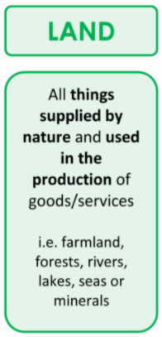

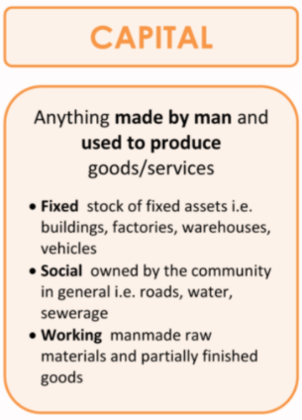

How can production take place?

Slide 6
What is the implication of Production to managers?
To know the optimal method of production by applying an understanding of production process
To obtain maximum efficiency as resources are costly and using them wisely is what a good managers do.
It gives insight on the linkages between production process and costs
helps managers to exert control over production costs by understanding and managing production technology.

Slide 7
In business world what do we understand by the term production?
transformation of input to output only
Other aspects beyond transformation of input to output
What are the other aspects?

Slide 8
Production
Production process include all activities related with providing goods and services :-
Employment practices
Acquisition of Capital Resources
Product Distribution
Managing Intellectual Resources

Slide 9
Production Function
Production function is the technical relationship between physical inputs and physical output.
Q = f (L, L_{b}, K, O, T, R)
Where, Q = Output
L = Land
L_{b} = Labor
K = Capital
O = Organization
T = Technology
R = raw Materials

Slide 10
Production Function - Types
Short Run Production Function
It refers to the production in the short run where there are some fixed factors.
Long Run Production Function
It refers to the production in the long run where all the factors are in variable supply.

Slide 11
Gulab sells all types of indian and nepalese sweets. With Tihar approaching, Gulab is expecting a surge in demand for sweets. How can Gulab deal with this surge?
by getting existing employees to take on extra shifts or work longer shifts
ordering additional raw materials for the production of baked goods
Notes:
📣 This is Slido interaction slide, please don't delete it. ✅ Click on 'Present with Slido' and the poll will launch automatically when you get to this slide.

Slide 12
Nanglo Bakery sells all types of baked goods. With increasing trend of migrants in the area, Nanglo Bakery is expecting a surge in demand for baked goods in coming years. How can Nanglo Bakery deal with this surge?
by hiring more employees
install and operate additional machinery to increase capacity
Notes:
📣 This is Slido interaction slide, please don't delete it. ✅ Click on 'Present with Slido' and the poll will launch automatically when you get to this slide.

Slide 13
Short-run Production Function
Law of Variable Proportions

Slide 14
SR Production Function with One Variable Input
Q = f (L_{b}, K)
Where, Q = Output
Lb = Labor
K = Capital - Fixed Factor

Slide 15
Total Product (TP)
Units of Capital (K) | Units of Labor (L) | Total Product (TP)
3 | 0 | 0
3 | 1 | 4
3 | 2 | 10
3 | 3 | 18
3 | 4 | 24
3 | 5 | 28
3 | 6 | 30
3 | 7 | 30
3 | 8 | 28
In the short run TP can be increased by employing more units of variable factor combined with fixed factor.

Slide 16
Total Product (TP)
Units of Labor (L) | Total Product (TP)
0 | 0
1 | 4
2 | 10
3 | 18
4 | 24
5 | 28
6 | 30
7 | 30
8 | 28
TP
TP
O
Units of Labor

Slide 17
Average Product (AP)
Units of Labor (L) | Total Product (TP) | Average Product (AP)
0 | 0 | 0
1 | 4 | 4
2 | 10 | 5
3 | 18 | 6
4 | 24 | 6
5 | 28 | 5.6
6 | 30 | 5
7 | 30 | 4.3
8 | 28 | 3.5
Average Product (AP) or) is the amount of output produced per unit of a variable factor during a specific time period.
AP = Total Product
Labor Input
AP= TP
L

Slide 18
Average Product (AP)
Units of Labor (L) | Total Product (TP) | Average Product (AP)
0 | 0 | 0
1 | 4 | 4
2 | 10 | 5
3 | 18 | 6
4 | 24 | 6
5 | 28 | 5.6
6 | 30 | 5
7 | 30 | 4.3
8 | 28 | 3.5
AP
AP
O
Units of Labor

Slide 19
Marginal Product (MP)
Units of Labor (L) | Total Product (TP) | Marginal Product (MP)
0 | 0 | 0
1 | 4 | 4
2 | 10 | 6
3 | 18 | 8
4 | 24 | 6
5 | 28 | 4
6 | 30 | 2
7 | 30 | 0
8 | 28 | - 2
Marginal Product (MP) is the change in Total Product due to the change in employing one extra unit of a variable factor.
MP = Change in Total Product
Change in Labor Input
MP= ΔTP
ΔL

Slide 20
Marginal Product (MP)
Units of Labor (L) | Total Product (TP) | Marginal Product (MP)
0 | 0 | 0
1 | 4 | 4
2 | 10 | 6
3 | 18 | 8
4 | 24 | 6
5 | 28 | 4
6 | 30 | 2
7 | 30 | 0
8 | 28 | - 2
MP
O
Units of Labor
MP

Slide 21
TP, AP & MP with Law of Variable Proportions
Law of Variable Proportion states that as we combine more and more of the variable factor along with the fixed factor, TP initially increases at an increasing rate, then at diminishing rate and then at a negative rate.

Slide 22
Law of Variable Proportions - Assumptions
State of technology is constant.
All units of the variable factor are homogenous.
There must always be some fixed input.

Slide 23
Three Stages of Law of Variable Proportions
Stage of Increasing Returns
Stage of Diminishing Returns
Stage of Negative Returns

Slide 24
Law of Variable Proportions
TPP
J
F
Point of Inflexion
TPP_{L}
E
L | TP | AP | MP
0 | 0 | 0 | 0
1 | 4 | 4 | 4
2 | 10 | 5 | 6
3 | 18 | 6 | 8
4 | 24 | 6 | 6
5 | 28 | 5.6 | 4
6 | 30 | 5 | 2
7 | 30 | 4.3 | 0
8 | 28 | 3.5 | - 2
O
L
L1
L2
L3
APP
MPP
Stage I
Stage II
Stage III
E’
F’
APP_{L}
J’
O
L1
L2
L3
MPP_{L}
L

Slide 25
Law of Variable Proportions
Stage I
TPP
J
F
Point of Inflexion
TPP_{L}
E
MP>AP
After point E’ – MP is decreasing but more than AP
Up to Point E, TP increases at an increasing rate and MP will be maximum.
Stage I ends when MP = AP
O
L
L1
L2
L3
APP
MPP
Stage I
Stage II
Stage III
E’
F’
APP_{L}
J’
O
L1
L2
L3
MPP_{L}
L

Slide 26
Why does TP is increasing at an increasing rate in Stage I of Law of Variable Proportions?
there is greater cooperation and high degree of specialization between different units of the variable factor
Complete utilisation of the fixed factor
Because both MP and AP is increasing.
Notes:
📣 This is Slido interaction slide, please don't delete it. ✅ Click on 'Present with Slido' and the poll will launch automatically when you get to this slide.

Slide 27
Law of Variable Proportions
Stage II
TPP
J
F
Point of Inflexion
TPP_{L}
E
MP<AP
AP and MP both will be decreasing
The stage ends when MP = 0 and TP is maximum
O
L
L1
L2
L3
APP
MPP
Stage I
Stage II
Stage III
E’
F’
APP_{L}
J’
O
L1
L2
L3
MPP_{L}
L

Slide 28
Why does TP is increasing at a decreasing rate in Stage II of Law of Variable Proportions?
Scarcity of the fixed factor relative to the quantity of the variable factor
Indivisibility of fixed factor
Imperfect substitutability of the factors
Notes:
📣 This is Slido interaction slide, please don't delete it. ✅ Click on 'Present with Slido' and the poll will launch automatically when you get to this slide.

Slide 29
Law of Variable Proportions
Stage III
TPP
J
F
Point of Inflexion
TPP_{L}
E
MP<AP
MP is declining and is negative
AP is declining and is positive
TP is declining
O
L
L1
L2
L3
APP
MPP
Stage I
Stage II
Stage III
E’
F’
APP_{L}
J’
O
L1
L2
L3
MPP_{L}
L

Slide 30
Why does TP is decreasing in Stage III of Law of Variable Proportions?
Poor Coordination between Fixed and the Variable Factors
Excess Variable Factors to Fixed Factors
With continuous increase in variable factor, the advantages of specialization and division of labor start diminishing
Notes:
📣 This is Slido interaction slide, please don't delete it. ✅ Click on 'Present with Slido' and the poll will launch automatically when you get to this slide.

Slide 31
According to law of variable proportions, at which stage do you think a rational producer produce? Why?
Notes:
📣 This is Slido interaction slide, please don't delete it. ✅ Click on 'Present with Slido' and the poll will launch automatically when you get to this slide.

Slide 32
In which stage does the producer produce
TPP
J
F
Point of Inflexion
TPP_{L}
E
A producer does not operate in Stage I.
In this stage, the marginal product increases with an increase in the variable factor.
Therefore, the producer can employ more units of the variable to efficiently utilize the fixed factors.
Hence, the producer would prefer to not stop in Stage I but will try to expand further.
O
L
L1
L2
L3
APP
MPP
Stage I
Stage II
Stage III
E’
F’
APP_{L}
J’
O
L1
L2
L3
MPP_{L}
L

Slide 33
In which stage does the producer produce
TPP
J
F
Point of Inflexion
TPP_{L}
E
Producers do not like to operate in Stage III either.
In this stage, there is a decline in total product and the marginal product becomes negative.
In Stage III, he incurs higher costs and also gets lesser revenue thereby getting reduced profits.
O
L
L1
L2
L3
APP
MPP
Stage I
Stage II
Stage III
E’
F’
APP_{L}
J’
O
L1
L2
L3
MPP_{L}
L

Slide 34
In which stage does the producer produce
TPP
J
F
Point of Inflexion
TPP_{L}
E
Any rational producer avoids the first as well as third stages of production.
Therefore, producers prefer Stage II – the stage of diminishing returns.
This stage is the most relevant stage of operation for a producer according to the law of variable proportions as it guarantees that MP is +ve, TP is increasing and maximizes.
O
L
L1
L2
L3
APP
MPP
Stage I
Stage II
Stage III
E’
F’
APP_{L}
J’
O
L1
L2
L3
MPP_{L}
L

Slide 35

Short Run Production Function - AP & MP
Production Function:-
Q = 30X+11X²-1.1X³
AP = TP/X = 30 + 11X - 1.1X²
MP = dTP/dX = 30 + 22X - 3.3X²
Optimum output a rational producer will produce when MP=0 (When TP will be maximum.
30 + 22X - 3.3X²= 0
X = 7.828
So, a rational producer will no go beyond hiring 7.828 units of X

Slide 36
Long-run Production Function
Law of Returns to Scale

Slide 37
How can you distinguish between long run and short run?
Enough time to increase the scale of production like building bigger factory, expanding the outlets
Firms can enter or leave a market.
Prices have time to adjust
Price elasticity of demand can vary
Notes:
📣 This is Slido interaction slide, please don't delete it. ✅ Click on 'Present with Slido' and the poll will launch automatically when you get to this slide.

Slide 38
LR Production Function with Two Variable Input
One of the decisions a firm can face in the long run is which combination of factors of production to use.
Economic efficiency involves choosing those factors so that the cost of production is at minimum.
Q = f (L_{b}, K)
Where, Q = Output
L_{b} = Labor
K = Capital

Slide 39
Understanding LR Production Function with Two Variable Input
Graphical analysis of Isoquant and Isocost Analysis

Slide 40
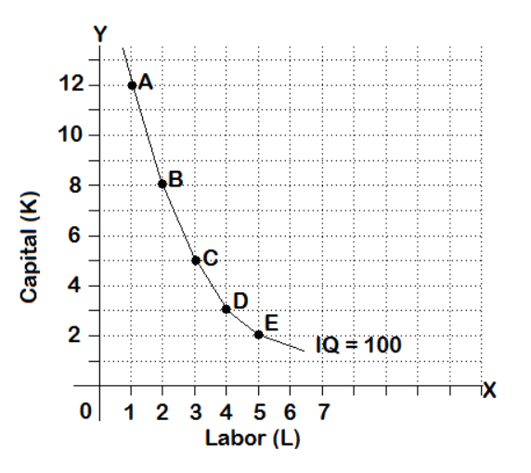
Isoquant
Isoquant or Iso-product curve shows different combinations of labor and capital with which a firm can produce a specific desired quantity of output.
It is the locus of all the technically efficient combinations of inputs which yield a given amount of output.
MRTS = MP_{L}/MP_{K}

Slide 41
Isoquant curve shows different combinations of labor and capital with which a firm can produce a specific desired quantity of output.
What does it imply to the producer?
It shows firm’s flexibility when making production decisions.
Notes:
📣 This is Slido interaction slide, please don't delete it. ✅ Click on 'Present with Slido' and the poll will launch automatically when you get to this slide.

Slide 42
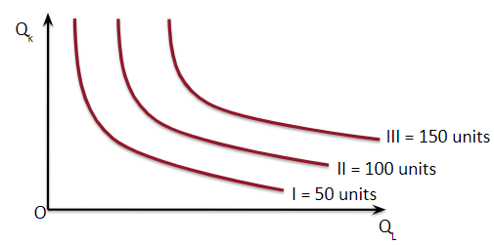
Isoquant Map
Isoquant or Iso-product map is the set of Isoquants family.
The further away the Isoquant from the origin the higher will be the level of output
The technical possibilities of production are represented by the isoquant map

Slide 43
Why do you think Isoquants are always downward sloping?
Because if a firm wants to produce the same level of output, then if he uses more of labor then use of capital needs to be reduced.
Notes:
📣 This is Slido interaction slide, please don't delete it. ✅ Click on 'Present with Slido' and the poll will launch automatically when you get to this slide.

Slide 44
Isoquant - Features
The Isoquants are always downward sloping meaning that if a firm wants to use more of labor then it must use less of capital to produce the same level of output or to remain on the same Isoquant.
The isoquants never intersect each other.
The higher the Isoquants away from the origin higher is the level of output produced.
The Isoquants are convex to the origin due to diminishing Marginal Rate of Technical Substitution (MRTS)

Slide 45
Isoquant - What is MRTS?
The slope of an isoquant is called MRTS of labor for capital.
The slope measures the degree of substitutability of the factors or in other words it means that within limits, labor and capital can be substituted for each other.
MRTS is defined as the amount of capital that the firm is willing to give up in exchange for labor, so that output level remains constant.

Slide 46
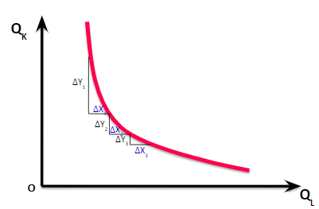
Isoquant - Why Diminishing MRTS?
The slope of an Isoquant decreases as we move down along an Isoquant showing increasing difficulty in replacing capital for labor as they are imperfect substitutes.
MRTS = MP_{L}/MP_{K}
ΔY₁/ ΔX₁ > ΔY₂ / ΔX₂ > ………. > ΔY_{n/} ΔX_{n}

Slide 47
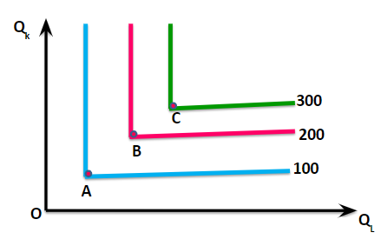
Isoquant - In case of Fixed Proportions of Inputs
When the isoquants are L-shaped, only one combination of labor and capital can be used to produce a given output.
For additional output more capital and labor are added in specific proportions. Adding more capital alone or labor alone does not increase output.
This implies that the methods of production are limited.

Slide 48
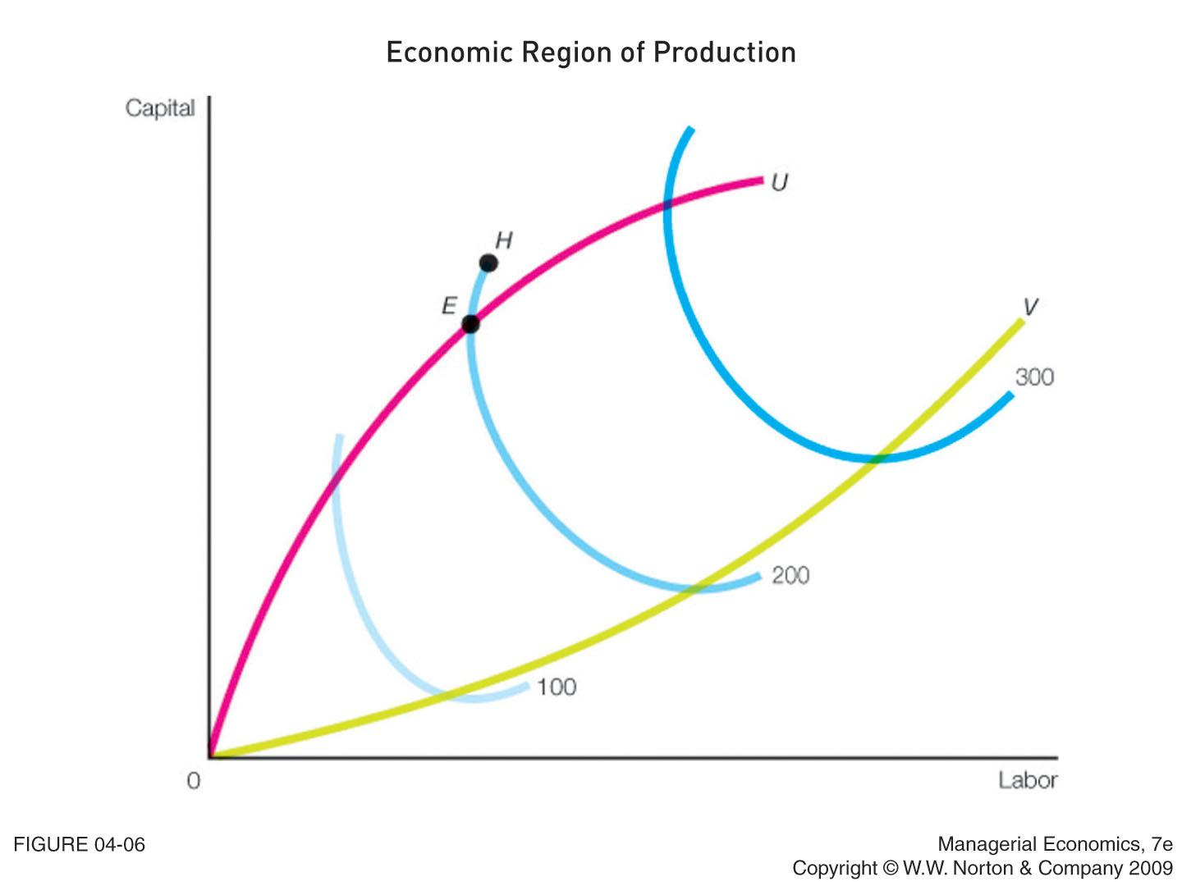
Isoquant - Ridge Lines
Economic region of production is located within the ridge lines.

Slide 49
A rational producer would always like to be in the highest possible Isoquant. But what restricts him to be on the highest Isoquant?
Notes:
📣 This is Slido interaction slide, please don't delete it. ✅ Click on 'Present with Slido' and the poll will launch automatically when you get to this slide.

Slide 50
Isocost
Isocost line is a line that shows the different possible combinations of two inputs, which a producer can buy that yields him the same cost irrespective of the combination he chooses given his budget and the prices of factor inputs.
Anywhere on the isocost line a producer is spending his entire budget either on capital or on labor or the combination of both.
The prices of input used for production of the particular product is represented by the isocost line.

Slide 51
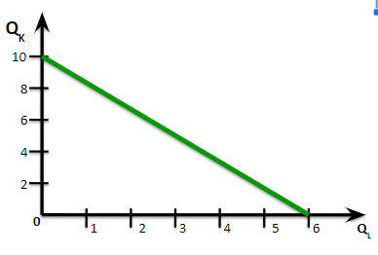

Isocost Lines
Say labor costs $5 per unit and machinery costs $3 per unit and that the firm has chosen to spend $30.Then Isocost line will be as follows:-
C = wL + rK
where C = Total Cost
w = wage rate
r = rate of interest
L = labor employed
K = Capital

Slide 52
Can Isocost line shift or rotate?
Yes
When do you think the Isocost line shift or rotate?
With a change in the spending of the firm - it shifts either to right or left
With a change in the price of any of the factors- it rotates either to right or left
Notes:
📣 This is Slido interaction slide, please don't delete it. ✅ Click on 'Present with Slido' and the poll will launch automatically when you get to this slide.

Slide 53
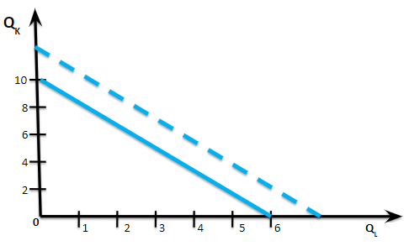
Shifts in Isocost Lines
With a change in the spending of the firm. If the spending increases then Isocost line will shift.

Slide 54
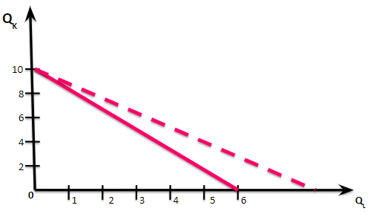
Shifts in Isocost Lines
With a change in the price of any of the factors. If the price of labor decreases then Isocost line will shift.

Slide 55
How do you think the Isoquant and Isocost curves analysis help a firm or a producer?
Notes:
📣 This is Slido interaction slide, please don't delete it. ✅ Click on 'Present with Slido' and the poll will launch automatically when you get to this slide.

Slide 56
Optimal Combination of Inputs
Optimum use for employment of inputs is also known as the least cost combination of variable inputs
For profit maximization the firm seeks to minimize cost of production for producing a given quantity of output or maximize output for the given level of cost outlay.
The choice of particular combination of factors or inputs depends upon the technical possibilities of production and prices of factors of production.

Slide 57
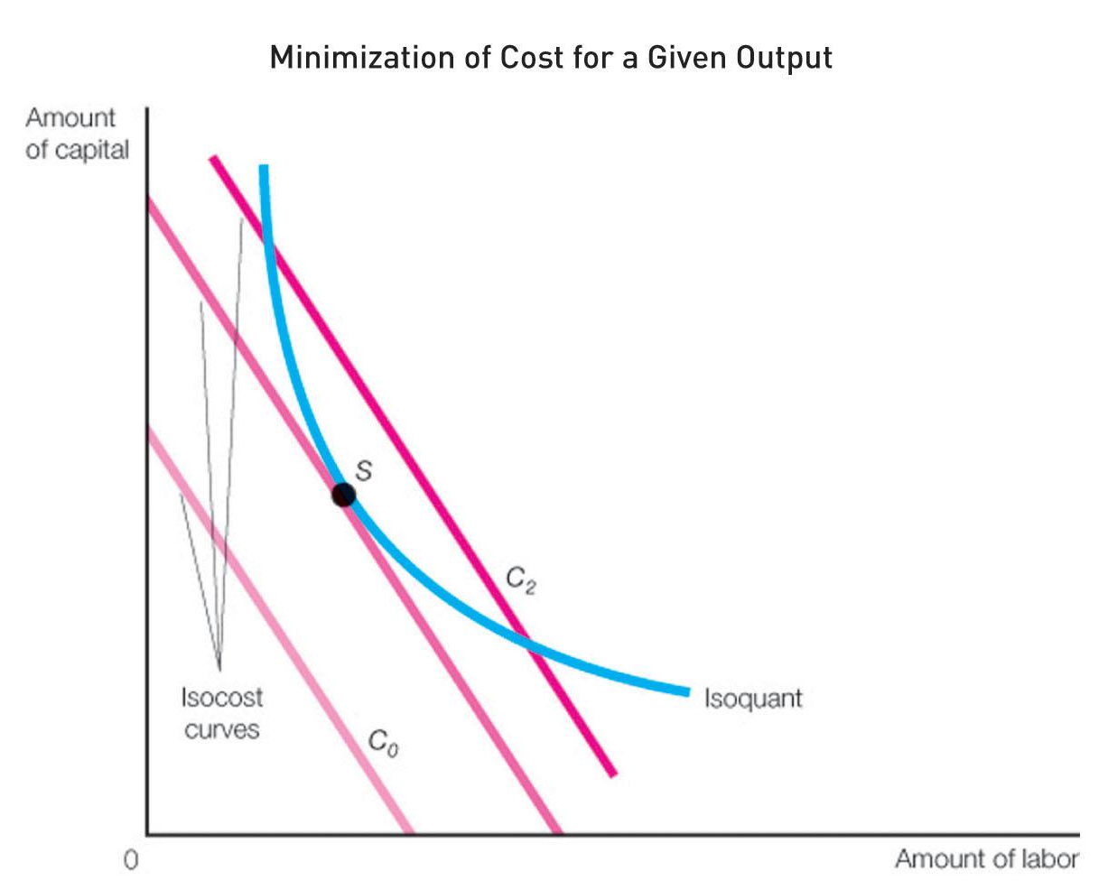

Output Maximization subject to Output Constraint
A rational form of producer
seeks to minimize cost at
the given level of output.
This is the situation in
which producer or firm is
faced with output constraint.
A
B

Slide 58
Optimal Combination of Inputs - Equilibrium Conditions
Slope of Isoquant
MRTS = MP_{L}/MP_{K}
Slope of Isocost = P_{L}/P_{K} = -w/r
Equilibrium at : Tangency between isocost and isoquant
MP_{L}/MP_{K} = -w/r
Marginal product per dollar spent should be the same for all inputs.
MP_{a}/P_{a} = MP_{b}/P_{b} = … = MP_{n}/P_{n}

Slide 59
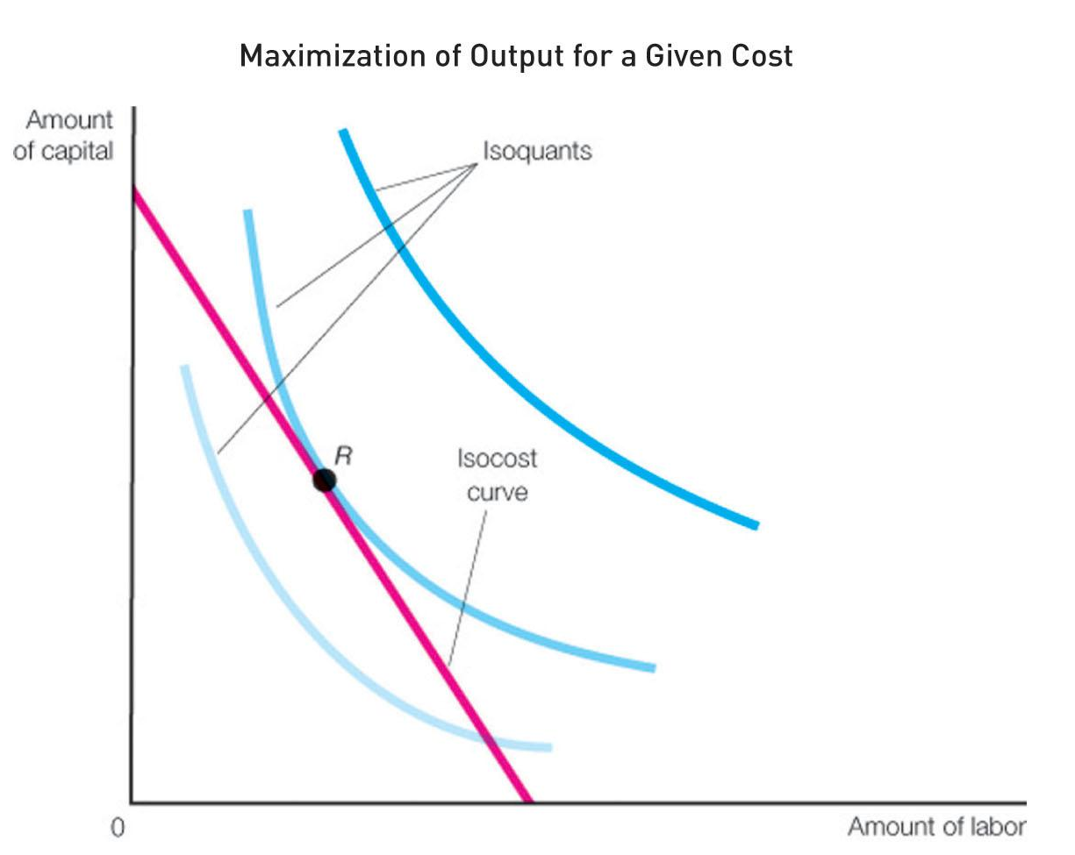
Output Maximization subject to Cost Constraint or Financial Constraint
A rational form of producer
seeks to maximize output at
the given cost outlay.
This is the situation in which
the form of producer is fixed
with the resource constastraint and seeks to maximize the output.

Slide 60
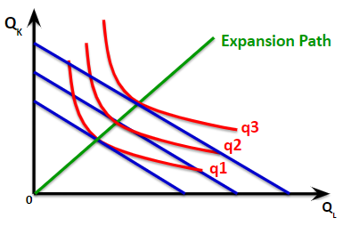
Optimal Combination, Economic Efficiency and Expansion Path
In the expansion path from the origin through points A, B and C shows the lowest cost combination of labor and capital that can be used to produce each level of output in the long run.
C
B
A

Slide 61
Economic Efficiency and Input Substitution
When price changes : With an decrease in the price of labor, the isocost curve becomes flatter and the producer will substitute OK₂ , OL₂ combination of capital and labor instead of OK₃, OL₃ to produce the same level of output.
Q_{K}
K3
C
K1
A
K2
B
q1
q2
0
L1
L3
L2
Q_{L}

Slide 62
Law of Returns
The law of returns to scale states that when all factors of production are increased in same proportion, the output will increase but the increase may be at an increasing rate or constant rate or decreasing rate.

Slide 63
3 Aspects of Law of Returns
Three Aspects of Law of Returns
Increasing returns to scale: When output increases by a larger proportion than inputs
Decreasing returns to scale: When output increases by a smaller proportion than inputs
Constant returns to scale: When output increases by the same proportion as inputs

Slide 64
Law of Returns - Increasing Returns to Scale?
Units of Labor (L) | Units of Capital (K) | Total Units of Inputs (L+K) | Total Product (TP)
1 | 1 | 1L+1K | 5
2 | 2 | 2L+2K | 12
4 | 4 | 4L+4K | 30

Slide 65
Why do you think the increasing returns to scale occur?
Because some technologies can only be implemented at a large scale of production
Because law of large numbers may reduce risk as scale increases
Notes:
📣 This is Slido interaction slide, please don't delete it. ✅ Click on 'Present with Slido' and the poll will launch automatically when you get to this slide.

Slide 66
Law of Returns - WHY Increasing Returns to Scale?
Indivisibilities: Some technologies can only be implemented at a large scale of production.
Subdivision of tasks: Larger scale allows increased division of tasks and increases specialization.
Probabilistic efficiencies: Law of large numbers may reduce risk as scale increases.

Slide 67
Increasing Returns to Scale
Q_{K}
TP
The isoquants move closer together as inputs are increased along the line.
30
20
10
O
Q_{L}

Slide 68
Constant Returns to Scale
The isoquants are equally spaced together as inputs are increased along the line.
Q_{K}
TP
Units of Labor (L) | Units of Capital (K) | Total Units of Inputs (L+K) | Total Product (TP)
1 | 1 | 1L+1K | 5
2 | 2 | 2L+2K | 10
4 | 4 | 4L+4K | 20
20
10
5
O
Q_{L}

Slide 69
Law of Returns - Decreasing Returns to Scale?
Units of Labor (L) | Units of Capital (K) | Total Units of Inputs (L+K) | Total Product (TP)
1 | 1 | 1L+1K | 5
2 | 2 | 2L+2K | 8
4 | 4 | 4L+4K | 12

Slide 70
Why do you think decreasing Returns to scale occur?
Because larger organizations are more difficult to manage
Because designing efficient compensation systems in large organizations is difficult
Notes:
📣 This is Slido interaction slide, please don't delete it. ✅ Click on 'Present with Slido' and the poll will launch automatically when you get to this slide.

Slide 71
Law of Returns - WHY Decreasing Returns to Scale?
Coordination inefficiencies: Larger organizations are more difficult to manage.
Incentive problems: Designing efficient compensation systems in large organizations is difficult.

Slide 72
Decreasing Returns to Scale
Q_{K}
TP
The isoquants move further away as inputs are increased along the line.
30
20
10
O
Q_{L}

Slide 73
Cost

Slide 74
Costs
To produce goods and services, we need factors of production that are scarce in nature and have alternative uses.
These FOP are NOT free.
Therefore, to produce goods and services, the producers need to expend money on FOP.
This is the costs of producing the goods and services

Slide 75
What types of costs do you think are incurred in the short run?
Fixed Costs and Variable Costs
Notes:
📣 This is Slido interaction slide, please don't delete it. ✅ Click on 'Present with Slido' and the poll will launch automatically when you get to this slide.

Slide 76
Production and Short Run Costs
The short-run costs are the costs over the period during which some factors are in fixed supply – like plant, machinery etc.
Fixed Costs- Costs incurred on fixed factors of production
Variable Costs - Costs incurred on variable factors of production
Short Run Costs = Fixed cost + Variable cost

Slide 77
Short Run Costs
Total Cost
Total Fixed Costs
Total Variable Costs
Total Cost = Total Fixed Cost + Total Variable Cost

Slide 78
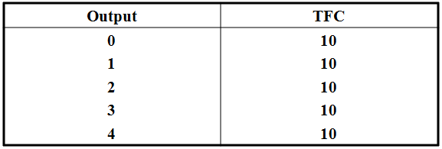
Fixed/Overhead Cost
Costs
10
TFC
TFC curve is a
horizontal line
0
Output
Overhead expenses, Wages/Salaries, Depreciation of Machinery, Insurance Amount etc.

Slide 79
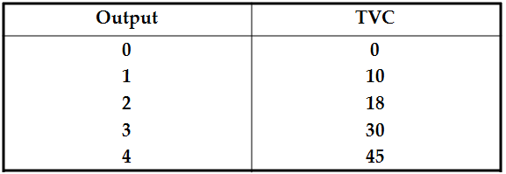
Variable/Prime Cost
TVC
Costs
TVC curve is an inverse S-shaped curve
0
Output
Cost of direct labor, Running expenses like cost of raw materials, fuels etc.

Slide 80
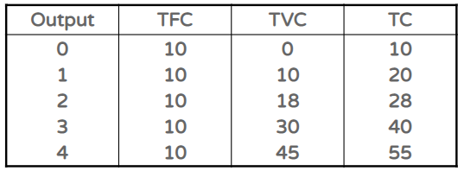
Total Cost
TC
TVC
Costs
TFC
TFC
TC curve is an inverse S-shaped
curve
0
Output

Slide 81
Short Run Average Costs
Average Total Cost
Average Fixed Costs (AFC = TFC / Q)
Average Variable Costs (AVC = TVC / Q)
Average Total Cost / Unit Cost = Average Fixed Cost + Average Variable Cost

Slide 82
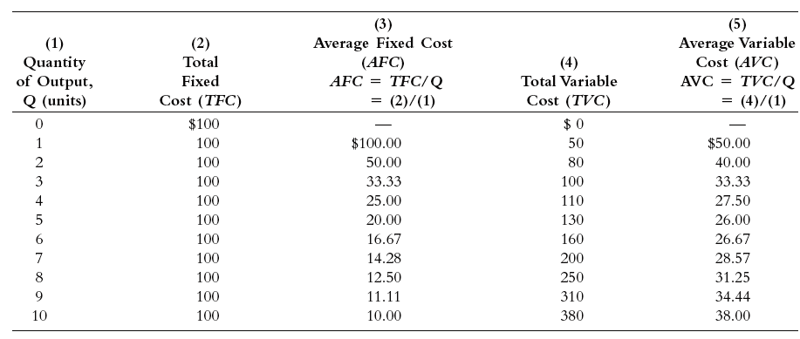
Short Run Average Fixed Costs & Average Variable Costs

Slide 83
TFC and AFC
TFC
In Rs.
AFC
in Rs.
TFC
AFC
O
Q
O
Q

Slide 84
TVC and AVC
TVC
In Rs.
AVC
in Rs.
TVC
AVC
O
Q
O
Q

Slide 85
TC and ATC
TC
In Rs.
TC
AVC
in Rs.
ATC
O
Q
O
Q

Slide 86
AFC, AVC and AC Curves
Costs
AVC
ATC
Short run AC curve is a vertical summation of AFC and AVC curves.
ATC = AFC + AVC
AFC
O
Q1
Q2
Q3
Output

Slide 87
As more output is produced, ATC comes very close to AVC but will not intersect. Why?
Because AFC can never be zero
Notes:
📣 This is Slido interaction slide, please don't delete it. ✅ Click on 'Present with Slido' and the poll will launch automatically when you get to this slide.

Slide 88
Short Run Marginal Cost
Marginal Cost - The change in total cost that results from a change in output: MC = ΔTC/Δ Q or MC = TC_{n} – TC_{n-1}

Slide 89

Short Run Marginal Cost
Output | TFC | TVC | TC | MC
0 1 2 3 4 | 10 10 10 10 10 | 0 10 18 30 45 | 10 20 28 40 55 | -
1-0 = 1
20-10= 10
10/1
10
2-1 = 1
28-20= 8
8/1
8
3-2 = 1
40-28= 12
12/1
12
4-3 = 1
55-40= 15
15/1
15

Slide 90
Short Run Marginal Cost
Output | TFC | TVC | TC | MC
0 1 3 9 14 | 10 10 10 10 10 | 0 10 18 30 45 | 10 20 28 40 55 | -
1-0 = 1
20-10= 10
10/1
10
3-1 = 2
28-20= 8
8/1
8/2
4
12/6
9-3 = 6
40-28= 12
12/1
2
16-11 = 5
15/5
55-40= 15
15/1
3

Slide 91
Short Run Marginal Cost Curve
MC
MC
Output
O
MC curve is U-shaped curve

Slide 92
Short Run Marginal Cost and Average Cost Curves
MC
MC
AC
O
a
b
Output

Slide 93
AFC, AVC, AC and MC Curves
Costs
MC
AVC
ATC
MC cuts ATC and AVC at its minimum points
AFC
O
Output

Slide 94
What are the components of long run costs?
Variable costs only as there are no fixed factors of production
Notes:
📣 This is Slido interaction slide, please don't delete it. ✅ Click on 'Present with Slido' and the poll will launch automatically when you get to this slide.

Slide 95
Production and Long Run Costs
In the long run, there are no fixed costs, so variable costs are total costs.
Long Run Costs = Variable cost

Slide 96
Long Run Total Cost
Costs
SRTC3
LRTC
SRTC1
SRTC2
Output
O
LTC begins from the origin implying that in the long run the firm incurs only the variable costs.

Slide 97
Long Run ATC (LRATC)
A curve that shows the lowest (unit) cost at which the firm can produce any given level of output.
A firm attempts to maximize long run profits by selecting a short scale of plant that minimizes its costs.

Slide 98
Long Run ATC (LRATC)
LRATC
ATC
SATC₁
SATC₉
SATC₂
SATC₈
SATC₃
SATC₇
SATC₄
SATC₅
SATC₆
The long-run average total
cost curve is the heavily
shaded, blue smooth curve.
O
Quantity
The LRATC curve is not scalloped because it is assumed that there are so many plant sizes that the LRATC curve touches each SRATC curve at only one point.

Slide 99
Long Run ATC (LRATC) & Long Run Marginal Cost (LRMC)
LRAC
Costs
LRMC
Output
O

Slide 100
As a manager what do you think the long run AC tells you?
Whether and to what extent, larger plants have cost advantage over small ones
Notes:
📣 This is Slido interaction slide, please don't delete it. ✅ Click on 'Present with Slido' and the poll will launch automatically when you get to this slide.

Slide 101
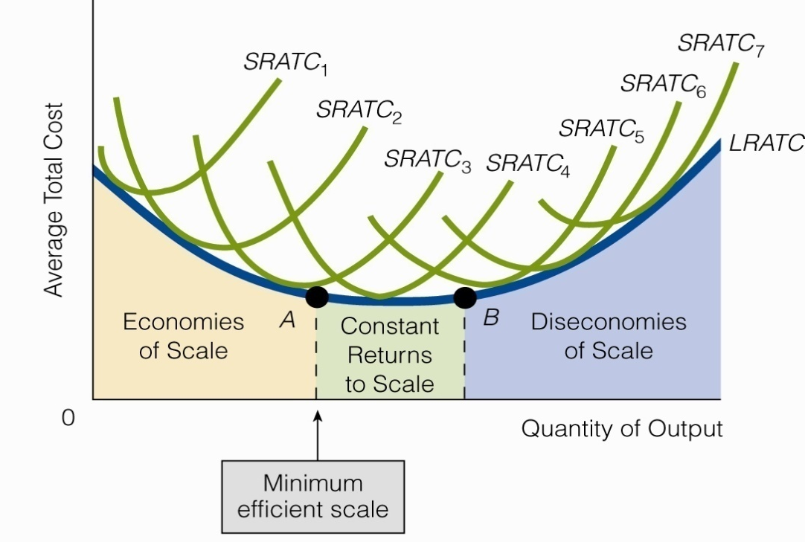
Scale of Economies and Managers
Economies of scale occur when the firm’s average unit cost decreases as output increases.

Slide 102
How to achieve Scale of Economies by Managers
Economies of scale are cost advantages companies experience when production becomes efficient, as costs can be spread over a larger amount of goods.
A business's size is related to whether it can achieve an economy of scale—larger companies will have more cost savings and higher production levels.
Economies of scale can be both internal and external. Internal economies are caused by factors within a single company while external factors affect the entire industry.

Slide 103
Which one of the following are the internal economies of scale?
Having a division of labor and management leading to labor specialization
Able to afford more expensive and yet more efficient equipment
Able to adapt to the latest technology that increases productivity
Able to adapt enhanced quality control measures
Able to use market information and knowledge in a better way
Notes:
📣 This is Slido interaction slide, please don't delete it. ✅ Click on 'Present with Slido' and the poll will launch automatically when you get to this slide.

Slide 104
Which one of the following are the external economies of scale?
Lower prices of its raw materials due to special discounts from its suppliers.
Lower rate of interest.
Massive advertisement campaigns by the firm
Lower transportation costs due to fall in oil prices
Notes:
📣 This is Slido interaction slide, please don't delete it. ✅ Click on 'Present with Slido' and the poll will launch automatically when you get to this slide.

Slide 105
Learning Curve
This curve shows the decline in the average cost (AC) of production with a rise in cumulative total output over time.
As firms gain experience in production of a commodity or service, their AC of production declines.
Long manufacturing experience enables firms to lower their AC of production.

Slide 106
Learning Curve
AC
AC1
AC2
AC3
LC
0
Q1
Q2
Q3
Cumulative Total Output

Slide 107
Scale of Economies & Managers
All managers have the opportunity to exploit the scale of economies in some form, though some fail to recognize their opportunities.

Slide 108

Can Scale of Diseconomies be felt by Managers
Yes.
When being so large that managers often find it difficult to coordinate work activities, communicate their directives to the right persons in satisfactory time, and monitor personnel effectively.
Overlapping and duplication of business functions and product lines

Slide 109
What can be the OPTIMUM SIZE of the firm for Managers
Optimum size of the firm denotes the size of the firm at which there is maximum efficiency in operation.
An optimum firm utilizes the existing conditions of technique with organizing ability so that the average cost of production is minimum.

Slide 110
Economies of Scope and Managers
An economy of scope means that the production of one good reduces the cost of producing another related good.
Economies of scope occur when producing a wider variety of goods or services is more cost effective for a firm than producing each good independently.
In such a case, the long-run AC and MC of a firm decreases due to the production of complementary goods and services.

Slide 111
Which statement is correct?
While economies of scope are characterized by efficiencies formed by volume, economies of scale are instead characterized by variety.
While economies of scope are characterized by efficiencies formed by variety and volume, economies of scale are instead characterized by volume only.
While economies of scope are characterized by efficiencies formed by variety, economies of scale are instead characterized by volume
Notes:
📣 This is Slido interaction slide, please don't delete it. ✅ Click on 'Present with Slido' and the poll will launch automatically when you get to this slide.

Slide 112
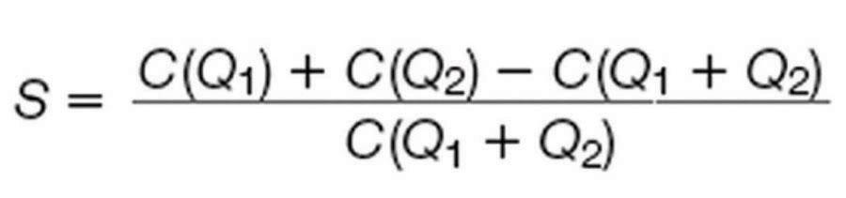

Economies of Scope and Managers
S = Degree of economies of scope
C(Q₁) = Cost of producing Q₁ units of product 1
C(Q₂) = Cost of producing Q₂ units of product 2
C(Q₁ + Q₂) = Cost of producing Q₁ units of product 1 and Q₂ units of product 2 (TV /radio/print media; univ education/consulting; refrigerator/AC, lawnmower/snowblower)
It measures the percentage of saving that results from producing jointly rather than individually.

Slide 113
Why do you think cost savings arise as explained by the Economies of Scope?
because of distribution process.
because of shared distribution process
because of shared resources
Notes:
📣 This is Slido interaction slide, please don't delete it. ✅ Click on 'Present with Slido' and the poll will launch automatically when you get to this slide.

Slide 114
Revenue

Slide 115
What is revenue to a firm?
Profit
Loss
Profit and Loss
Receipts from Sales
Notes:
📣 This is Slido interaction slide, please don't delete it. ✅ Click on 'Present with Slido' and the poll will launch automatically when you get to this slide.

Slide 116



What is Revenue?

Slide 117
Revenue - Types
Total Revenue
Average Revenue
Marginal Revenue

Slide 118
Total Revenue (TR)
TR is defined as the total or aggregate of proceeds to the firm from the sale of a commodity.
Symbolically,
TR = P X Q
P = Price
Q = Quantity

Slide 119
Average Revenue (AR)
Average Revenue is the revenue per unit of output sold.
Symbolically,
AR = TR
Q
or, AR = P x Q
Q
or, AR = P
AR is always identical with the price.

Slide 120
Marginal Revenue (MR)
Marginal Revenue is the revenue received by selling one extra unit of output.
MR = Change in Total Revenue
Change in Quantity Sold
MR = ΔTR
Δ Q
Also, MR _{n} = TR _{n} – TR _{n-1}

Slide 121
Revenue - When Price is Constant
Units sold | Price (P) | TR=PxQ | AR=TR/Q | MR
1 2 3 4 5 | 10 10 10 10 10 | 10 20 30 40 50 | 10 10 10 10 10 | 10 10 10 10 10
Revenue
TR
P
P=AR=MR=d
O
Here, AR=P=d
AR=MR
Quantity

Slide 122
Revenue - When Price is NOT Constant
Units sold | Price (P) | TR | AR | MR
1 2 3 4 5 6 7 | 10 9 8 7 6 5 4 | 10 18 24 28 30 30 28 | 10 9 8 7 6 5 4 | 10 8 6 4 2 0 -2
Revenue
PED = 1
TR
MR=0
AR
O
MR
Quantity
Here, AR=P=d but AR≠MR

Slide 123
Profit Maximization by Firms
A producer is said to be in equilibrium when he produces the level of output at which his profits are maximum.
It is a situation of profit maximization.

Slide 124
What is Profit?
Profit = TR-TC
Profit = TR - (TFC+TVC)
Profit = TR - TVC
Profit = TR-TFC-TVC
Notes:
📣 This is Slido interaction slide, please don't delete it. ✅ Click on 'Present with Slido' and the poll will launch automatically when you get to this slide.

Slide 125
Profit Maximization by Firms
Profit is the difference between total revenue and total cost:
π = TR - TC
Producer is in equilibrium at that level of output at which he is earning maximum profits i.e. the difference between TR and TC is maximum.

Slide 126
Profit Maximization by Firms with TR/TC Approach
TC
TR/TC
Profits are maximum where the following two conditions are satisfied.
1. The vertical
distance between
TR and TC is maximum.
2. Profits fall if one
more unit of output is produced.
Break Even Point
TR
π
X_{A}
X_{B}
X_{C}
At X_{A} and X_{C} π is zero. No-
profit-no-loss points

Slide 127
Profit Maximization by Firms with MR/MC Approach
MR/MC
MC
Profits are maximum where the following two conditions are satisfied.
1. MR=MC
2. MC curve must
be rising
MR
π
X_{B}

Slide 128
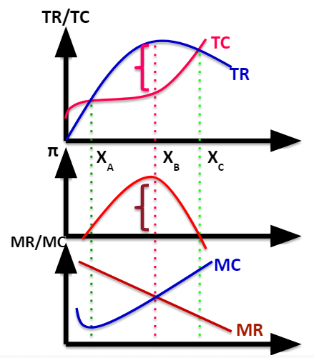
Profit Maximization by Firms - TR/TC & MR/MC Approach

Slide 129
Break Even and Managers
It looks at the relative positioning of costs and revenue and managers use it to estimate the relationships among sales and costs, receipts and profits.
It signifies the output level that must be reached if managers are to avoid losses
Q_{B} = TFC/(P – AVC)
TFC = Total fixed cost
P = Price
AVC = Average variable cost

Slide 130
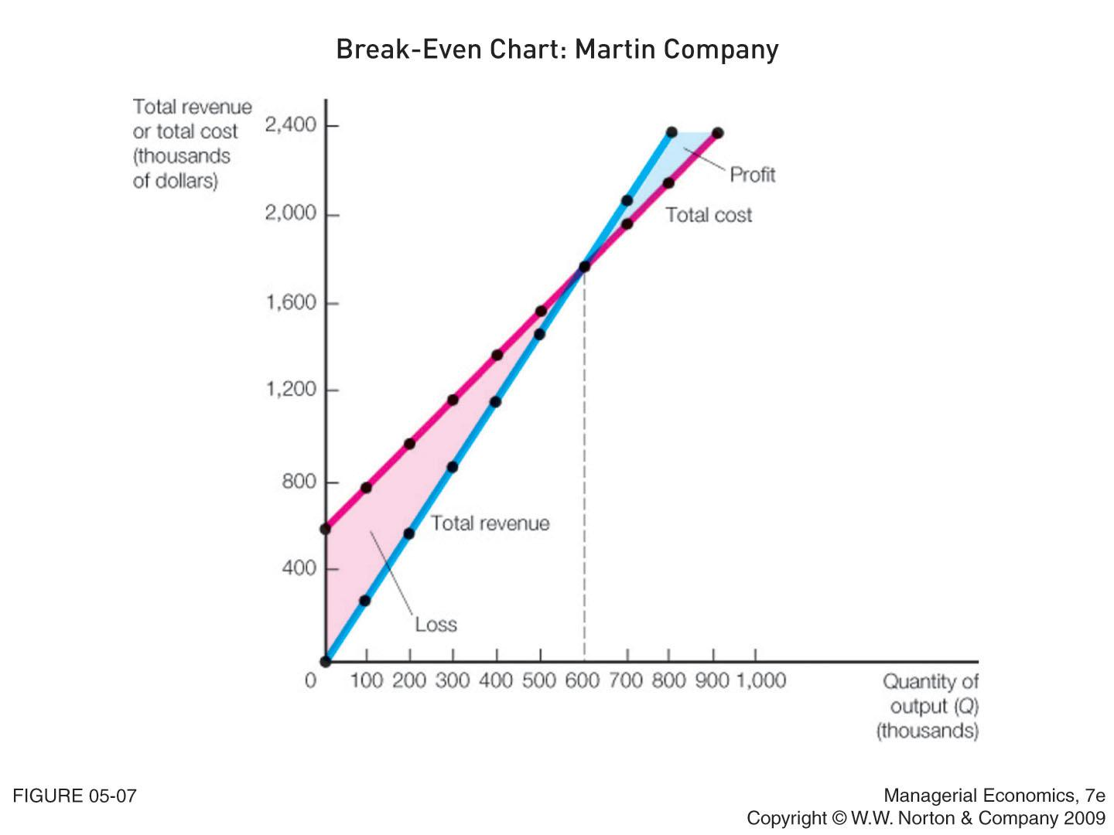
Break Even and Managers
Break Even
Q_{B} = TFC/(P – AVC)
TFC = $600,000
P = $3
AVC = $2
Q_{B} = 600,000
High variance in prices or difficulties in estimating cost structure can decrease the accuracy of results.

Slide 131
Profit Contribution Analysis for Managers
It is a break-even analysis to understand the relationship between price and profit
Q_{B’} = (TFC + Profit target)/(P – AVC)
Q_{B’} = Minimum output level that will attain the profit target

Slide 132
Profit Contribution Analysis for Managers
Profit contribution analysis (Continued)
Example
Q_{B’} = ($600,000 + $1,000,000)/($3 – $2) = 1,600,000
TFC = $600,000
Profit target = $1,000,000
Price = $3
AVC = $2

Slide 133
How can we calculate Break Even?
QB = TFC/(AVC – AFC)
QB = TFC/(P – AVC)
QB = TFC/(TC – AVC)
QB = TFC/(TVC – AVC)
Notes:
C

Slide 134
NEXT
Market Structure and Pricing Strategies

